Slide 1
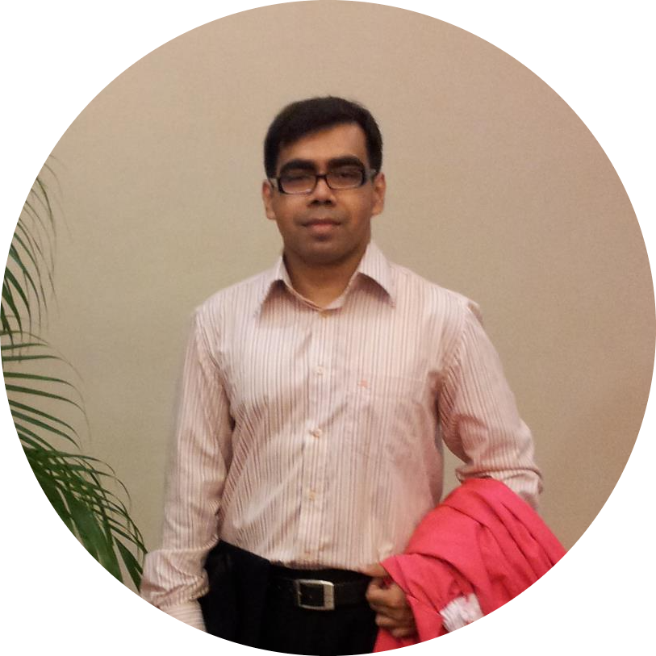
Supervised by:
American international university-Bangladesh
Software Requirement Engineering Summer 2021-2022
DR. MD. ABDULLAH - AL – JUBAIR
ASSISTANT PROFESSOR & HEAD-IN-CHARGE [UNDERGRADUATE PROGRAM]
COMPUTER SCIENCE

Slide 2
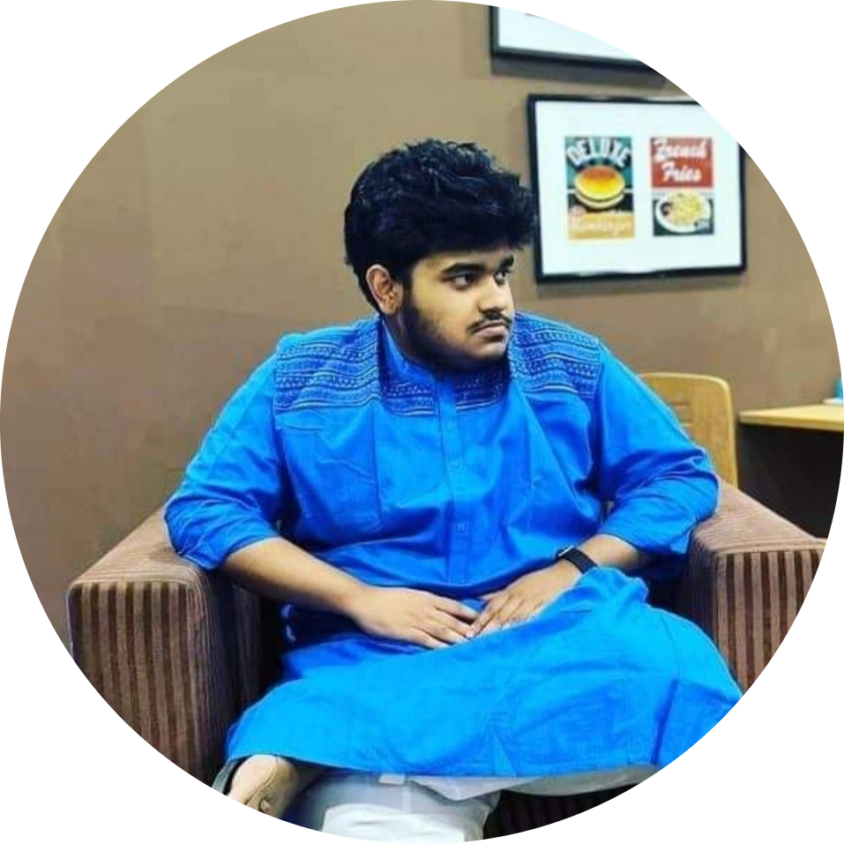



Team members
Ahmed, Nafiz
Saha, Anik Kumar
Akhtar, Ayesha
Choyon, Tonmoy Saha
19-412893-3
19-41289-3
19-41292-3
19-41293-3
Section: E
Serial: 34
Section: E
Serial: 35
Section: B
Serial: 40
Section: B
Serial: 41

Slide 3
INDEX
Brief description about problem statement
Concept of our application
User scenario description
Use case diagram
Activity Diagrams
Class diagram
User Interface Specification
Findings from this application
Challenges that might be faced
conclusion

Slide 4
Problem Statement
We who own pets have to face to many problems when it comes to giving our pets immediate aid/treatment. It’s a common scenario in every house who owns pets that they can’t get their pets immediate treatment because of so many reasons such as being unable to reach vets in time, not being able to know with whom to talk etc. Also, there is another problem and that is, we often encounter street animals getting injured on roads and feel helpless as by the time help reaches, it’s already too late sometimes. And additionally, it is also sometimes difficult to buy foods or toys for our pets from home. So, the problem statement as simple as that.

Slide 5
Concept of our Application
Our application is called “PetCare” which will have 4 types of users and they are pet owners, vets, shop owners, rescue center. This app will allow us to do certain operations such as,
The major goal of this application is to make the above mentioned daily works easier for pet owners as well as for the pets. And the target market for our app are mainly the vets, pet owners, shop owners and rescue centers but in general this app will be helpful for all.
• Request for rescue • Post pictures and videos • Search for adoption • Buy foods and toys • Update products | Update pet info Approve rescue request Approve adopting request Do consultation

Slide 6
User Scenario
Pet Owner
Shop Owner
I want to do registration in this app
I want to request for rescue for street animals
I want to post pictures and videos of my pet
I want to do consultation with vets
I want to search for pet adoption
I want to buy foods and toys for my pet
I want to do registration
I want to update available products so that customer can buy from y shop

Slide 7
User Scenario Continuation
Veterinarian
Rescue Center
I want to do registration
I want to provide consultation to my customers
I want to do registration
I want to approve rescue requests
I want to approve adoption requests

Slide 8
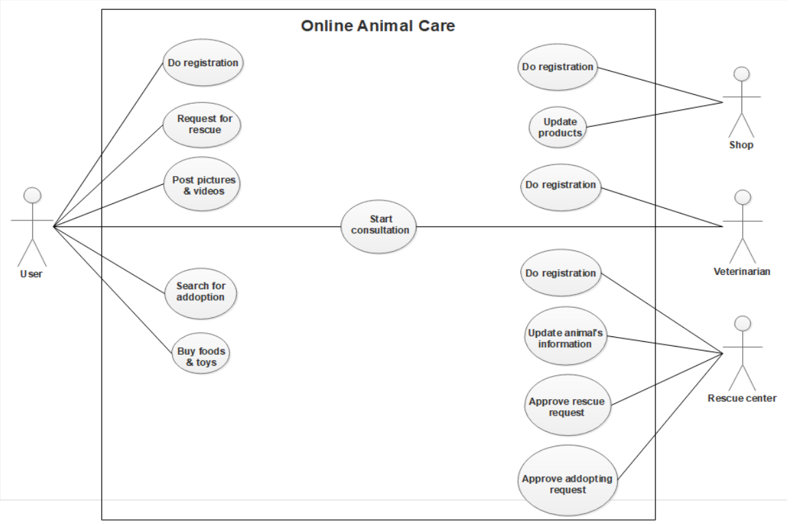
Use Case Diagram

Slide 9
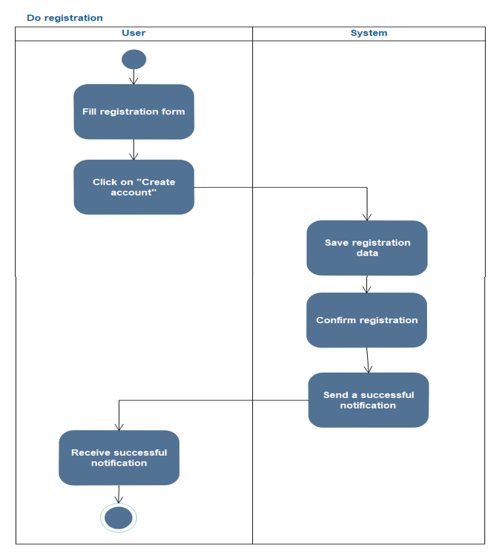
Activity Diagram

Slide 10
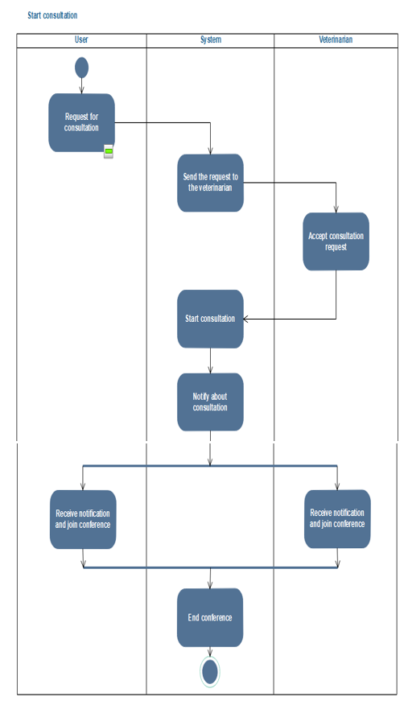
Activity Diagram Continuation

Slide 11
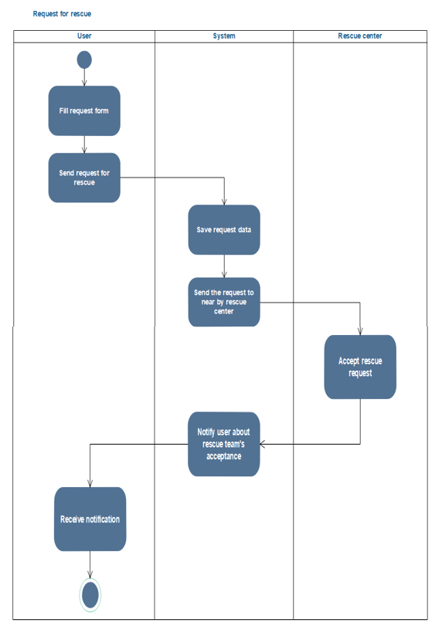
Activity Diagram Continuation

Slide 12
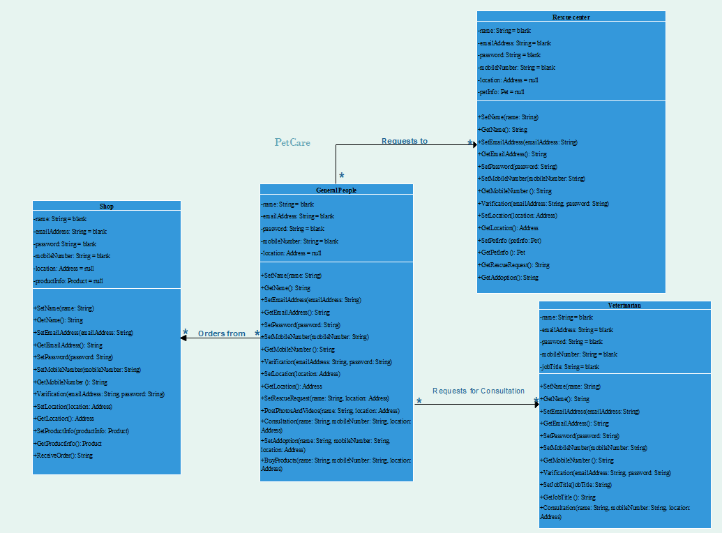
Class Diagram

Slide 13
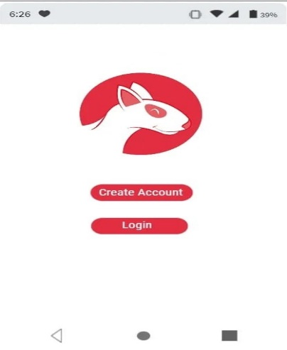
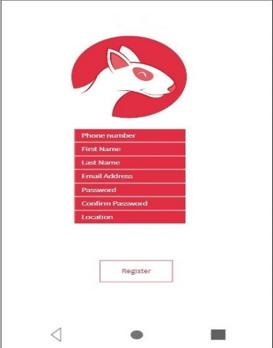
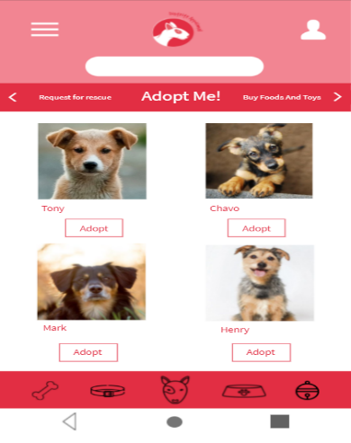
Ui Design Specification
Home Page
Registration Page
Adoption Page

Slide 14
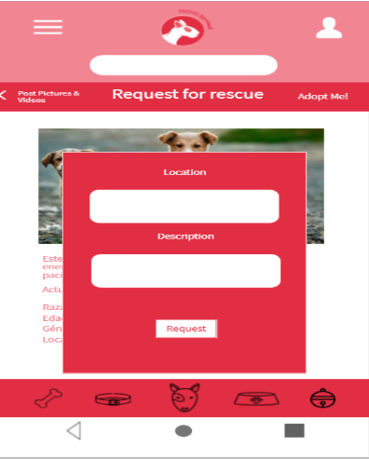
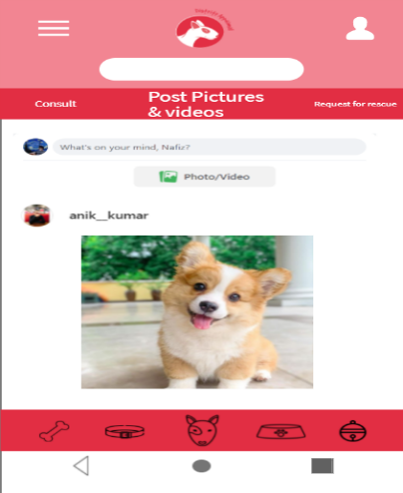
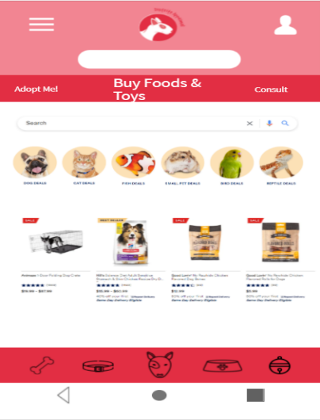
Ui Design Specification Continuation
Rescue Request Page
Posting Page
Buying Page

Slide 15
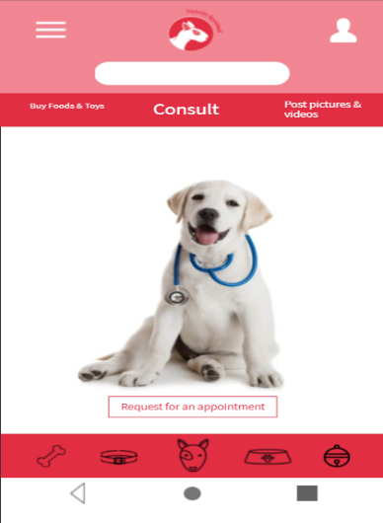
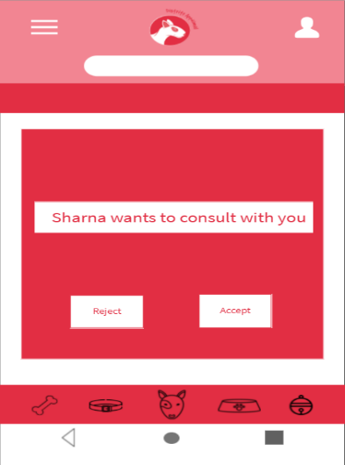
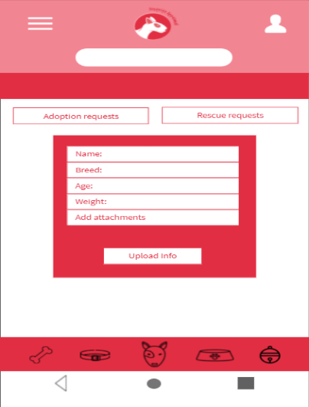
Ui Design Specification Continuation
Consulting Page (Pet Owner)
Consulting Page (Vet)
Pet Update Page

Slide 16
Findings
Some of the major findings are-
•This application can help all classes and types of people
•People can easily get access to vets, rescue centers and pet shops
•Rescuing and adopting animals will get much easier with the help of this app
•Street animals’ or pets’ unnatural death rate can be reduced

Slide 17
Challenges
Some of the challenges we might face-
•Security issues
•Protecting intellectual properties
•Long-term financial support
•Keeping up with client demand
•Maintenance

Slide 18
Conclusion
As this project’s main purpose is to ensure health care and rescue operation for pets and street animals also as this project doesn’t target any specific age group of people so, if this project is implemented correctly, this can be huge beneficial to everyone including injured, unsheltered animals and pets.

Slide 19
Thank You

